Slide 1
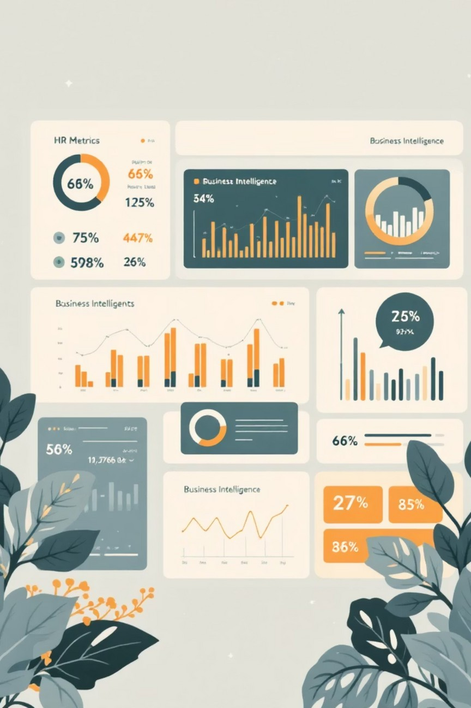
HR Analysis & Performance Insights
Analyzing HR data to gain insights into employee performance, attrition trends, and overall workforce distribution across departments and roles. Evaluating performance ratings, experience levels, and demographic factors to identify patterns impacting productivity and retention. Identifying key reasons for employee departures and highlighting departments or roles most affected by attrition to support data-driven HR decisions and workforce planning.

Slide 2
Project Overview: Driving HR Decisions
Goal Identification
Identify why employees leave and which departments, roles, or locations are most affected.
Dashboard Creation
A Power BI dashboard shows key HR metrics: total employees, attrition rate, exits by department, performance, and job role.
Impact & Decisions
Helps HR teams understand trends and make better decisions for retention and performance.

Slide 3

Dataset Description: The Foundation of Our Analysis
This dataset contains comprehensive HR employee information, including department, job role, gender, performance score, engagement score, start date, exit date, and attrition status. The data was carefully cleaned, transformed, and analyzed using Python and SQL to ensure accuracy and consistency. An interactive HR analytics report was then developed in Power BI to visualize key metrics, uncover workforce trends, and provide actionable insights into employee performance, engagement, and attrition patterns.

Slide 4


Exploratory Data Analysis with Python
01
Data Loading & Understanding
HR dataset loaded into Python using pandas; checked structure, column names, and data types.
02
Summary Statistics & Missing Values
Analyzed numerical column distributions and handled missing values for data quality.
03
Data Cleaning & Feature Engineering
Renamed columns, fixed inconsistencies, and created new features like age, tenure, and performance levels.
04
Data Validation & Export
Verified new columns and loaded the cleaned data into PostgreSQL for further analysis and reporting.

Slide 5
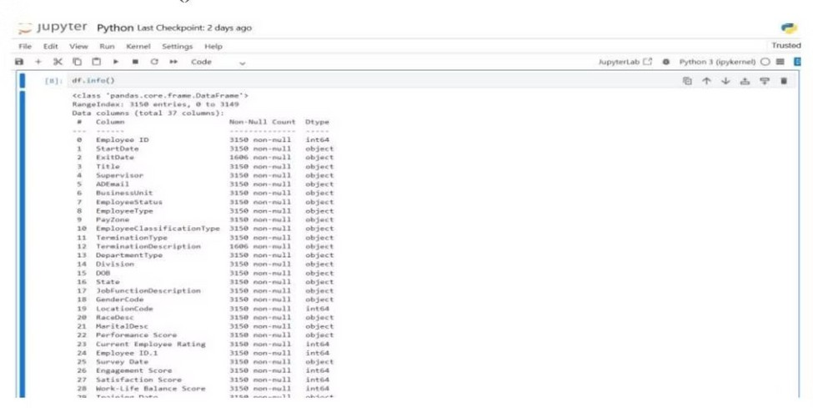
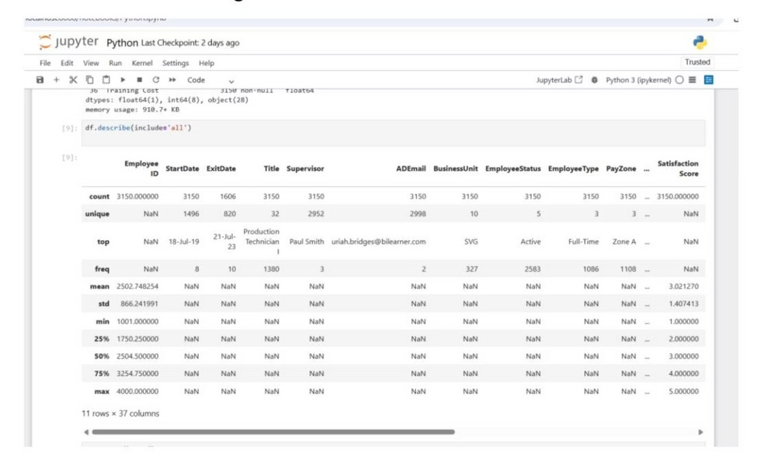
Data Understanding: Initial Insights
Dataset Structure
Initial view of the dataset structure, column names, and data types using df.info() and df.head().
Summary Statistics
Detailed statistical overview of numerical columns (age, scores, ratings) using df.describe().

Slide 6

Data Analysis using SQL: Key HR Questions
Employee Exits & Attrition
Counted total employees who left and identified departments with the highest attrition rates.
Demographic & Location Trends
Compared gender-based attrition and found locations with the highest employee exits.
Tenure & Performance Impact
Calculated average tenure before exit and checked if low-performing employees leave more frequently.
Current Workforce & High-Risk Roles
Counted active employees by department and identified job roles with high turnover.

Slide 7
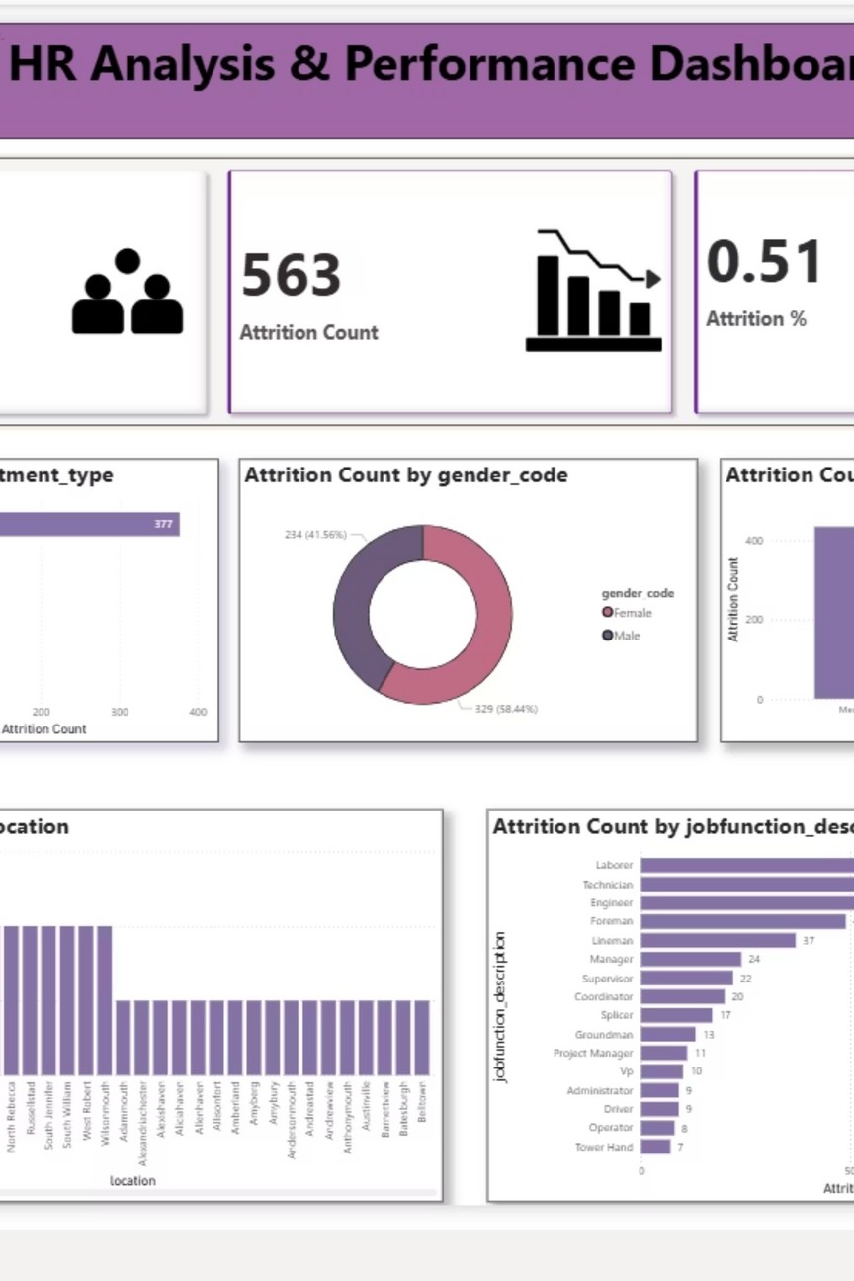
HR Analytics Dashboard: Power BI Overview
An interactive Power BI dashboard was created to help HR teams monitor workforce trends and make data-driven decisions. The dashboard visualizes key HR metrics such as total employees, attrition rate, performance levels, engagement scores, and workforce distribution across departments, job roles, gender, and experience levels. It enables easy identification of attrition patterns, high-risk areas, and performance gaps through dynamic filters and drill-down features. These insights support HR professionals in improving employee retention, performance management, and strategic workforce planning.

Slide 8



Dashboard Highlights: Key Insights
Employee Overview
Total employees, number of exits, attrition rate, and average tenure.
Attrition Insights
Departments with highest exits, male vs. female attrition, and performance level impact.
Workforce Details
Identifies high-risk job roles and locations with more employee exits.
Performance & Engagement InsightsExamines the relationship between employee performance scores and engagement levels to identify productivity gaps, disengaged employee segments, and opportunities for performance improvement and retention strategies.

Slide 9

Business Recommendations: Actionable Strategies
1
Improve Retention
Focus on high-attrition departments with targeted strategies.
2
Boost Engagement
Enhance employee engagement for low-performing groups.
3
Strengthen Early Tenure
Implement robust retention programs for new employees.
4
Monitor Trends
Regularly track location-wise attrition to address issues promptly.

Slide 10

Conclusion: Data-Driven HR for a Stronger Workforce
The HR Analysis & Performance Dashboard offers a clear view of attrition, performance, and workforce distribution. Using Python, SQL, and Power BI, key metrics were analyzed and visualized to identify high-risk areas.
This enables HR teams to make data-driven decisions, improving employee retention, performance management, and overall workforce planning.

